Slide 1
Identifying HARPed Loans
January 2016

Slide 2
INTRODUCTION
Key Differences in Streamline Refi, HARP 1.0 and HARP 2.0 Programs
 | HARP 2.0 | HARP 1.0 | Streamline Refi
Period | Since Nov.2011 | Apr.2009-Oct.2011 | Pre-HARP 1.0
Appraisal | Mostly Automated | Manual/automated appraisal but manual appraisal required in most cases | Manual appraisal
Income & Asset documentation | Reduced requirement in Sep. 2012--same servicer are required to verbally verify a borrower's income; New lenders are required to have documentation | Need documentation In some cases need two year history of income | Stated Income/employment
Rep & warrant | Further relief of rep & warrant for original loan in Sep. 2012; Relief of new loan rep & warrant risk with 12 month clean pay following origination | Seller retains all the original rep & warrant regarding value condition and marketability; no additional relief on the new loan | Any previous rep & warrant relief on original loans does not apply to new loan
LTV restriction | Extended to above 125 LTV in Oct. 2011 | LTV ceiling at 105 when announced in Mar. 2009 Raised ceiling from 105 to 125 in Jul. 2009 | under 95-100
MI | MI transfers made easier | No new MI required but transfer of MI is cumbersome | Standard
LLPA | Lowered LLPA to 75bp max | Standard | Standard

Slide 3
INTRODUCTION
1
Importance of identifying HARP loans
Loans that have been refinanced through the Home Affordable Refinance Program (HARP) generally prepay slower than other refinance loans that have undergone full underwriting. As a streamline refinance program, HARP generally made only minimal requirements of borrowers, and such borrowers may have trouble qualifying for regular refinances.
2
Existing algorithms for identifying HARPed Loans
Prior to August 2013:
This is the period prior to Freddie Mac providing loan-level credit information for fully underwritten mortgages
MI matches were used to identify potential HARPed loans with OLTV > 80% and loan purpose as Refi-NCO (No Cash-out)
Although HARP targets with LTVs > 80%, loans with lower OLTVs are counted as part of HARP because the Agencies essentially suspended their streamline refi programs after the financial crisis and currently rely on the HARP program for all streamline processing
After August 2013:
New Freddie Mac and Fannie Mae loan-level credit information are used to identify 30-year fixed –rate HARP loans by mapping the credit dataset to the standard database without restrictions on the LTV ratio
The credit data set has about a one year lag, which means that recently originated loans cannot be identified as being HARPed or not using the current algorithm

Slide 4
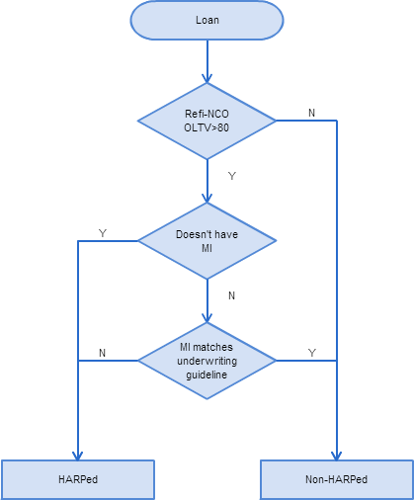
EXISTING ALGORITHM I MI Matching Method
Three Step Mapping
Step 1: The loan should be originated after June 2009 as a refi-NCO loan, with Origination LTV >80%. Otherwise, it’s Non-HARPed.
Step 2: If the loan doesn’t have MI, we match it as HARPed loan;
If not, go to step 3.
Step 3: For the loans that potentially carry over MI check whether MI matches current underwriting guidelines. If there’s no match, then it’s a HARPed loan.
Cons
Cannot match loans with OLTV equal or lower than 80%.
Highly sensitive to the correctness of MI underwriting guidelines.

Slide 5
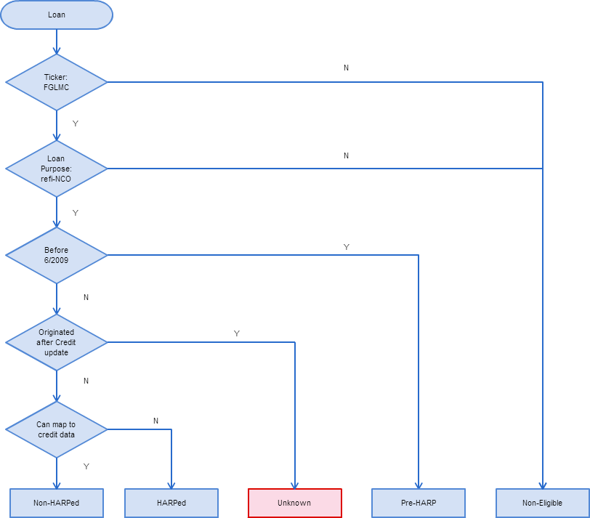
EXISTING ALGORITHM II Credit Dataset Mapping Method
Credit Data Mapping
No restrictions on OLTV > 80%.
More accurate as there is no dependency on MI underwriting criteria.
Cons
The credit data set has about a one year lag, meaning we don’t have the most recent origination data. Consequently, we have to mark the HARP status as unknown for recently (within the last year) originated loans.

Slide 6
EXISTING ALGORITHM II Results from the Credit Dataset Mapping Method
Pre-HARP
HARPed
Non-HARPed
Non-eligible: Purchas, refi-CO
The blue area can be consider as non-HARPed loans; brown area is HARPed loans percentage.
Red area is the loans originated within the most recent year. The credit dataset has a gap on this area.
Need to improve the mapping for the red area.

Slide 7
ENHANCED ALGORITHM
Y: HARPed
HARP% = 100
LTV > 80
MI Test
Using Algo I
N: Non-HARPed
HARP% = 0
HARP % for each loan
Unknown Refi Loans
LTV <= 80
Ratio
HARP/Total Refi using Algo II
HARP% = Ratio from last step
Estimate a percentage chance the loan is originated from HARP program for each loan.

Slide 8
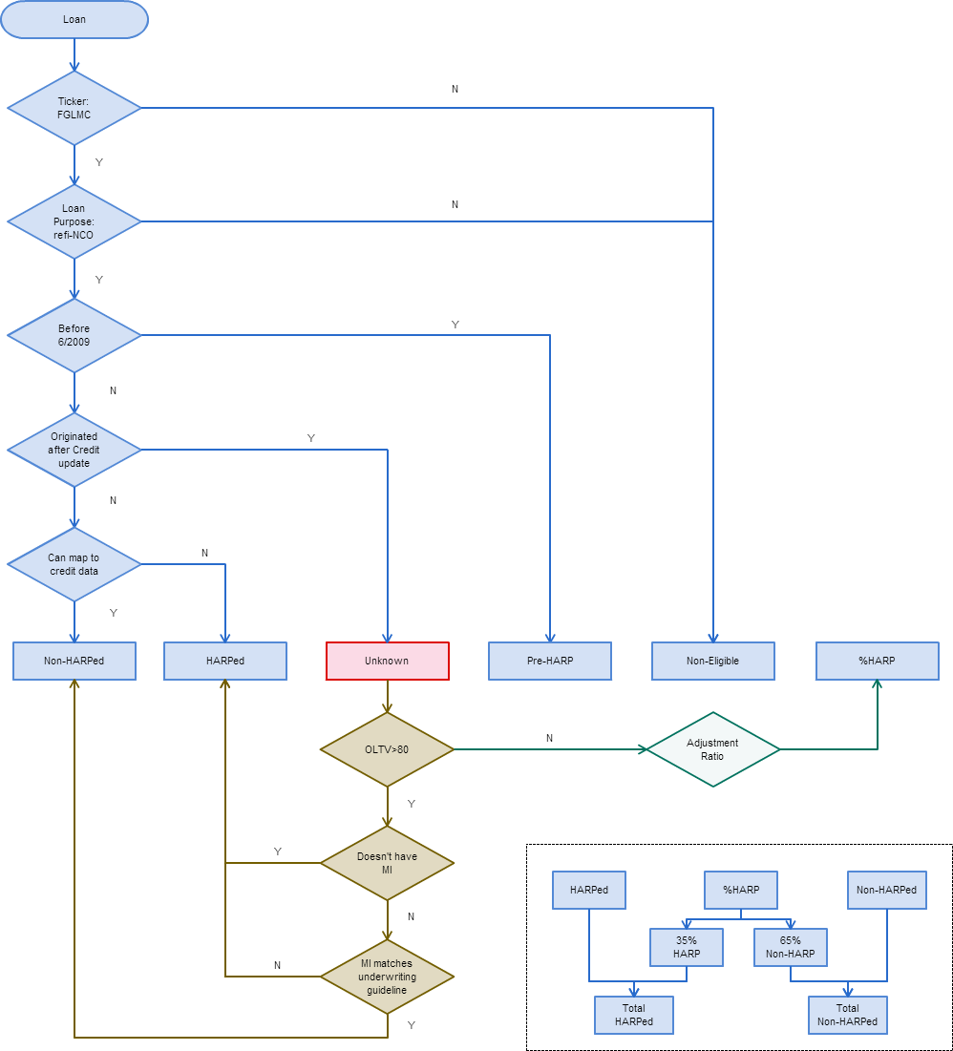
ENHANCED ALGORITHM
As of
Algorithm II
2009.01
...
2014.01
2016.01
120
Mapped Data | Un-mapped Data
Mapped Data | Un-mapped Data
OLTV
One-year gap, unable to map recent year HARP loans.
80
...
30
As of
Algorithm I
2009.01
...
2014.01
2016.01
120
Mapped Data | Mapped Data
Un-mapped Data | Un-mapped Data
OLTV
80
...
Unable to map HARP loans with LTV <= 80.
30
As of
Enhanced Algo.
2009.01
...
2014.01
2016.01
120
Mapped Data | Mapped Data
Mapped Data | % HARP Adjust.
Integrate Algo II into Algo I for the unknown one year gap.
OLTV
80
...
30

Slide 9
ENHANCED ALGORITHM Adjustment Factor: LTV > 80
In order to find out whether we need to adjust the result from the MI mapping algorithm, we test the two algorithms with LTV>80 loans. The HARP mapping numbers from them are fairly close to each other. In other words, there is no bias between the two mapping methods. Therefore, there is no need to adjust the result for LTV > 80 loans.

Slide 10


ENHANCED ALGORITHM Adjustment Factor: LTV <= 80
For the loans with LTV <= 80, we use a % HARP adjustment factor to estimate the probability that a loan is coming from HARP program.
We generated the factor by calculate the ratio by:
$FHL Ratio= \frac{HARP Loan Number}{Total Refi−NCO Loan Number}$ ×100%
$FNMA Ratio= \frac{HARP Loan Number}{Total Refi Loan Number}$ ×100%
We use the credit mapping method to calculate the ratio based on the historical data.
The HARP % ratio is around 20% for FNMA and 35% for FHL according to the chart above. That means among all the loans originated within the recent one year with LTV <= 80, about 20% of them are coming from HARP program.

Slide 11
ENHANCED ALGORITHM
Pre-HARP
HARPed
Non-HARPed
Non-Eligible: Purchas, refi-CO
Using the Enhanced Algorithm
Pre-HARP
HARPed
Non-HARPed
Non-Eligible: Purchas, refi-CO

